Slide 1
EverX PosteriorTM
from GC
Fibre-reinforced composite for dentin replacement in large restorations

Slide 2
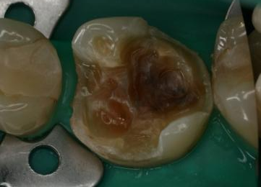
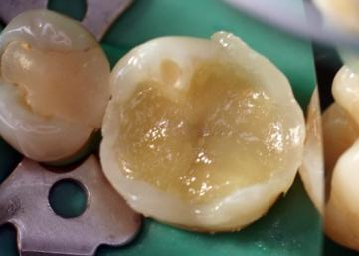
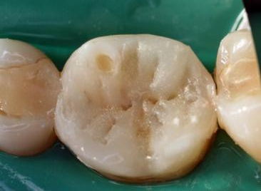
What is everX Posterior ?
What is everX Posterior?
everX Posterior is a fibre-reinforced composite
designed to replace damaged tissue, especially dentin, in large size cavities
in conjunction to conventional composite such as G-aenial Posterior used as enamel replacement.
The combination of both materials allows to
restore teeth in a bio-mimetic way and
to prevent and stop crack propagation.
GC everX Posterior is the strongest composite sub-structure that helps you to extend beyond the current limitations of direct restorations
Dr Marinova, Bulgaria

Slide 3
Rationale for development
Fracture of restorations & Tooth fractures are common issues
A study has shown a failure rate of 14.9% in class II composite restorations after 7 years¹. The most common reasons for failure were:
Fracture of resin composite
Secondary caries.
Cusp fracture
Another study has shown that fracture was the main cause of restoration replacement²
In adults the longevity varied from 6.4 to 7.3 years.
In 2007, 34 % of the restorations were made due to primary caries, 22 % due to secondary caries and 31 % due to fracture or loosening of the restoration (n = 3 785)
¹ Clinical performance of a hybrid resin composite with and without an intermediate layer of flowable resin composite: A 7-year evaluation. van Dijken JWV, Pallesen U. Dent Mat 2011 27:150-156
² Materials and longevity of dental restorations in Finland (Korjaavan hoidon käytännöt), Forss H, Widström E. 2011. Finnish Dent J 12/2011:26-31.
Notes:
van Dijken JWV, Pallesen U. Clinical performance of a hybrid resin composite with and without an intermediate layer of flowable resin composite: A 7-year evaluation. Dent Mat 2011 27:150-156
The most common reason for failure of the composite restoration/fillings is the fracture of the composite followed by secondary caries.
The overall failure rate of Class II restorations after seven years was 14.9 % and nearly 50 % of them were composite fractures.
Forss H, Widström E. 2011. Materials and longevity of dental restorations in Finland (Korjaavan hoidon käytännöt), Finnish Dent J 12/2011:26-31.
In years 2011 a cross-sectional review study was published in Finland to obtain information about the longevity of composite restorations.
In adults the longevity varied from 6.4 to 7.3 years.
In 2007, 34 % of the restorations were made due to primary caries, 22 % due to secondary caries and 31 % due to fracture or loosening of the restoration (n = 3 785)

Slide 4
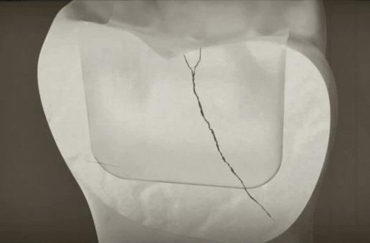
Rationale for development
Fractures...
often happen as a result of tens of thousands of repetitive bites
start from the surface of the conventional composite material and slowly propagate through the filling.
Notes:
According to literature (van Dijken 2011), the most common reason for failure of the composite restoration/fillings is the fracture of the composite followed by the secondary caries. The overall failure rate of Class II restorations after seven years was 14.9 % and nearly 50 % of them were composite fractures.
In general, the fracture often happens as a result of tens of thousands of repetitive bites. It starts from the surface of the conventional composite material and slowly propagates through the filling.
If one of the potentially hundreds or thousands of micro cracks is able to penetrate critically deep enough, the material suddenly gives up and fractures catastrophically under a fairly low stress compared to maximum bending stress. everX Posterior base is tested to prevent this kind of problem from occurring (Garoushi 2006, Garoushi 2007a).
everX Posterior base has been formulated to strengthen the filling, to stop crack propagation initiating from the material surface.

Slide 5
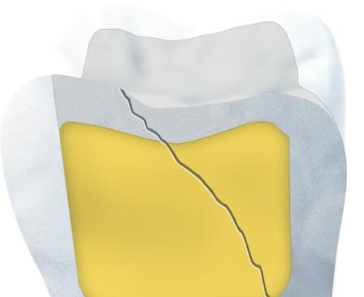
Rationale for development
Fractures start from the surface of the conventional composite material and slowly propagate through the filling.
nearly 50 % of failures in Class II composite restorations were fractures¹
Together with cusp fracture: 64,7%¹
¹ Clinical performance of a hybrid resin composite with and without an intermediate layer of flowable resin composite: A 7-year evaluation. van Dijken JWV, Pallesen U. Dent Mat 2011 27:150-156
Notes:
According to literature (van Dijken 2011), the most common reason for failure of the composite restoration/fillings is the fracture of the composite followed by the secondary caries. The overall failure rate of Class II restorations after seven years was 14.9 % and nearly 50 % of them were composite fractures.
In general, the fracture often happens as a result of tens of thousands of repetitive bites. It starts from the surface of the conventional composite material and slowly propagates through the filling.
If one of the potentially hundreds or thousands of micro cracks is able to penetrate critically deep enough, the material suddenly gives up and fractures catastrophically under a fairly low stress compared to maximum bending stress. XENIUS base is tested to prevent this kind of problem from occurring (Garoushi 2006, Garoushi 2007a).
XENIUS base has been formulated to strengthen the filling, to stop crack propagation initiating from the material surface.

Slide 6
How to prevent crack and crack propogation?
Problems with crack formation:
Difficulties in repairing/ strengthening the remaining tooth structure
Risk of cusp fracture
Ends in less residual tooth structure to bond to
Less longevity of the tooth on the arch
Risk of fracture under the gingival line
Extraction

Slide 7
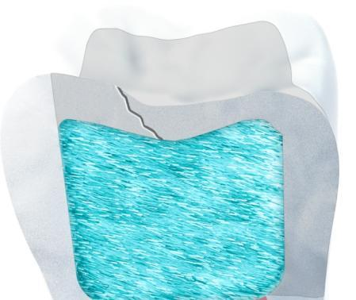
Fibre stop fracture propagation
everX Posterior has been designed to
Prevent fracture³
Stop and re-direct fractures towards a repairable situation.
3) Load bearing capacity of fibre-reinforced and particulate filler composite resin combination; Sufyan Garoushi* et al; Journal of Dentistry (2006) 34, 179–184

Slide 8
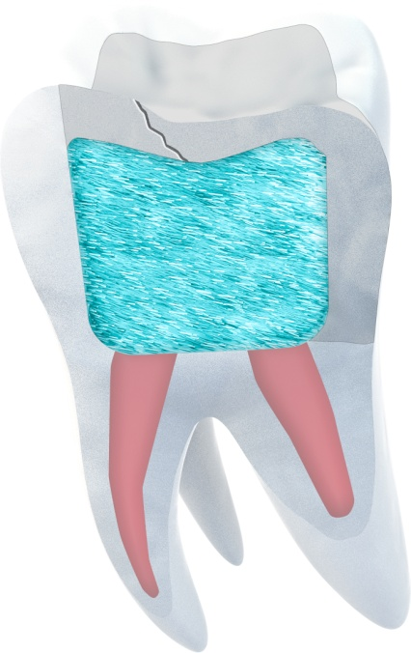
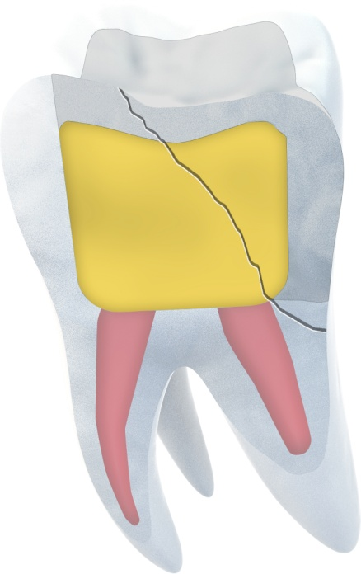
Looking for a solution to prevent cracks?
Discover the power of fibres everX PosteriorTM
Fibres prevent crack propagation
Crack propagation is arrested and redirected by the everX Posterior
substructure⁴
everX Posterior verstärkt Compositekronen signifikant in wurzelbehandelten Molaren: Frakturen sind leichter zu restaurieren
Composite
everX Posterior sub-structure
Composite sub-structure
Crack propagation is arrested.
Conventional composite: crack propagation through the filling AND the tooth structure
4. Lammi M, Tanner J, Le Bell-Rönnlöf A-M, Lassila L, Vallittu P. Restoration of endodontically treated molars using fiber reinforced composite substructure. J Dent Res 2011 90 (Spec Iss A): 2517
Notes:
Lammi M, Tanner J, Le Bell-Rönnlöf A-M, Lassila L, Vallittu P. Restoration of endodontically treated molars using fiber reinforced composite substructure. J Dent Res 2011 90 (Spec Iss A): 2517

Slide 9
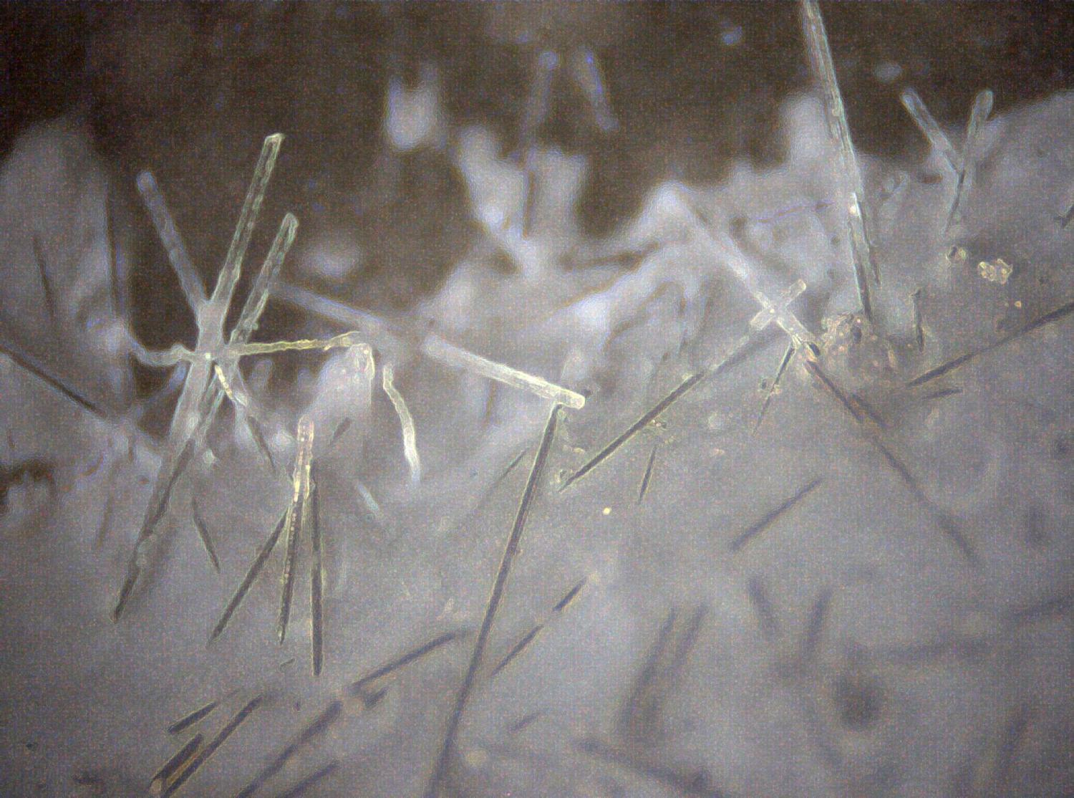
What is the added value of fibres?
Fibres…
... maximize strength
stop crack propagation
... maximize bonding

Slide 10
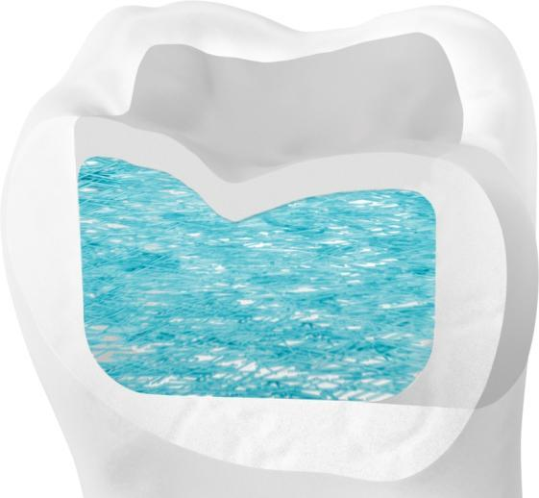
Fibres maximize STRENGTH
Fibres
Simulate the collagen in the dentin
form a network inside the composite (same principle as with the iron rebar used in construction), to make the material stronger
Strength makes everX Posterior a prefect sub-structure to reinforce any composite restoration in large size cavities.
Notes:
Source: University of Turku, Finland, 2010-2012, unpublished data
Source Dentine & Enamel: Imbeni et al. The dentin-enamel junction and the fracture of human teeth. Nature Mater 2005;4:229-232
Fracture toughness expresses material’s capability to resists fracture formation under load. It is measured by using pre-cracked test specimens which are loaded until the fracture occurs (ISO 20795-1*).
everX Posterior base has twice as high fracture toughness than any of the reference materials (conventional composites and/or bulk fill -composites) tested.
Clinical relevance: everX Posterior base will enhance the longevity of the filling, by preventing fractures.

Slide 11
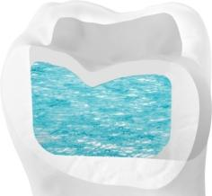
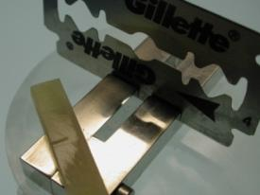
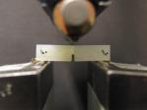
Fibres maximize STRENGTH
Results:
fracture toughness to the level of natural dentin and almost double to conventional composite
fracture toughness is a property which describes the ability of a material containing a crack to resist fracture under load
Pre-crack was made with a razor blade.
Test setup
Fracture Toughness (modified ISO 20795-1:2008 method)
University of Turku, Finland, 2010-2012 (unpublished data)
*Imbeni et al. The dentin-enamel junction and the fracture of human teeth. Nature Mater 2005;4:229-232
Notes:
Source: University of Turku, Finland, 2010-2012, unpublished data
Source Dentine & Enamel: Imbeni et al. The dentin-enamel junction and the fracture of human teeth. Nature Mater 2005;4:229-232
Fracture toughness expresses material’s capability to resists fracture formation under load. It is measured by using pre-cracked test specimens which are loaded until the fracture occurs (ISO 20795-1*).
everX Posterior base has twice as high fracture toughness than any of the reference materials (conventional composites and/or bulk fill -composites) tested.
Clinical relevance: everX Posterior base will enhance the longevity of the filling, by preventing fractures.

Slide 12

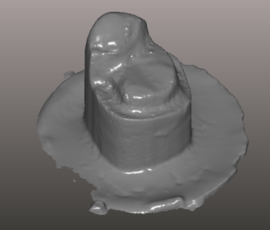
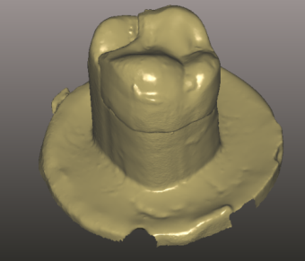
Fibres maximize STRENGTH
Load Bearing capacity of everX Posterior substructure in sandwich technique for onlay restoration (Garoushi, 2012)
Well above that of maximum biting force (Maximum biting force of healthy humans in posterior = 1000N)
Significantly higher than that of conventional composite alone
Increased fracture resistance = strengthening effect of fibres.
everX Posterior substructure, when used with conventional overlaying composite, is able to withstand well biting forces in the posterior area.
Group | Load bearing capacity
Plain PFC (Particulated Filler/ Conventional Composite) | 1081 (N)
PFC/ Conventional Composite with everX Posterior base substructure (sandwich technique) | 1405 (N)
Notes:
Garoushi S, Tanner J, Vallittu PK, Lassila L. 2012. Preliminary clinical evaluation of short fiber-reinforced composite in posterior teeth: 12-month report. Open Dent J 6:41-45.
Images showing test model (a) and final shape of the test specimen (b): the test specimens were loaded by universal testing machine until fracture of the restoration

Slide 13
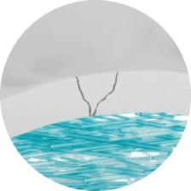
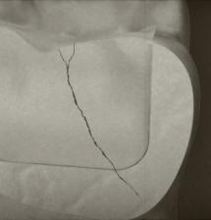
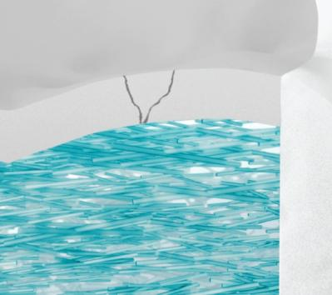
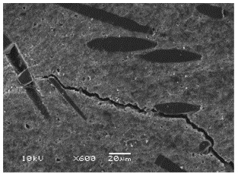
Fibres PREVENT CRACK Propagation
Fibres prevent and stop crack propagation (Garoushi 2006, Garoushi 2007)
Fibres will improve longevity of restorations since fracture of material and teeth are amongst of the major cause of composite failures
Conventional Composite
Fibre-reinforced composite
Notes:
Garoushi S, Lassila LV, Tezvergil A, Vallittu PK. 2006. Load bearing capacity of fiber-reinforced and particulate filler composite resin combination. Dent Mater 34(3):179-84
Garoushi S, Lassila LV, Vallittu PK. 2007a. Short glass fiber reinforced composite resin with semi-interpenetrating polymer network matrix. Dent Mater Nov; 23(11):1356-62

Slide 14
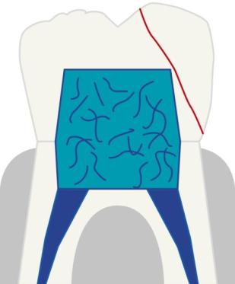
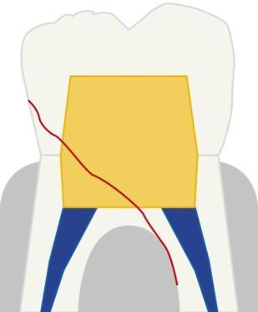
Fibre change fracture patterns of endo treated teeth
Crack initiated at tooth surface can be stopped & redirected away from tooth structure⁴
everX Posterior significantly reinforces composite crowns in endo treated molars resulting in more easy to restore fractures
Crack propagation under load
Predominant fracture types³ (favorable/unfavorable)
Composite Z250 crown
everX Posterior structure
Z250 substructure
Fracture line within the composite
REPAIR POSSIBLE
Fracture line within the composite AND Tooth structure
EXTRACTION ??
4 Lammi M, Tanner J, Le Bell-Rönnlöf A-M, Lassila L, Vallittu P. Restoration of endodontically treated molars using fiber reinforced composite substructure. J Dent Res 2011 90 (Spec Iss A): 2517
Notes:
Lammi M, Tanner J, Le Bell-Rönnlöf A-M, Lassila L, Vallittu P. Restoration of endodontically treated molars using fiber reinforced composite substructure. J Dent Res 2011 90 (Spec Iss A): 2517

Slide 15
Fibres increase fracture resistance
Maximum biting force of healthy humans in posterior = 1000N
Load bearing capacity of Xenius substructure in sandwich technique is well above that of maximum biting force
Load Bearing capacity (Garoushi 2006)
Group | 24-h water | 30-d water
Plain PFC | 1117 (137) | 861 (270)
PFC with XENIUS base substructure (FRC group) | 1935 (216) | 1700 (115)
Mean fracture load value (N) of onlay-shaped test specimen
Compressive load test set-up (onlay-shaped specimen)
Fracture type of Xenius type sub-structure (B) is less catastrophic than corresponding structure mode of PFC (A)
Notes:
1) PFC onlay restoration with XENIUS base type substructure had significantly higher load-bearing capacity (table below) and 2) the fracture type of PFC onlay restoration with XENIUS base type substructure was less catastrophic than corresponding structure made from PFC alone (images below the table).
Garoushi S Lassila LV, Vallittu PK. Fiber-reinforced composite substructure: Load-bearing capacity of an onlay restoration. Acta Odontol Scand 2006 64:281-285. The strengthening effect of the fibres is proven by increased fracture resistance. It can be concluded that material withstands well biting forces at posterior area.

Slide 16
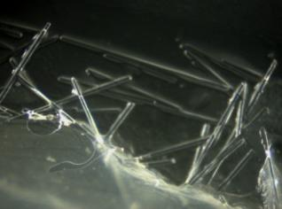
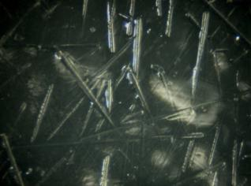
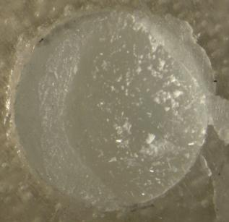
Fibres maximize BONDING
High shear Bond Strength to any overlaying composite
everX Posterior base- composite bond was mostly higher than corresponding composite-composite bond
High bond strength is due to – not only high chemical bond strength – but also the micromechanical retention created by the fibres at the interface.
Result: reliable sandwich structures
Notes:
Since everX Posterior will be used together with composites as a sandwich structure, the bond strength between the base material and the overlaying composite is an important factor.
The bond strength was measured by using shear bond strength method described in ISO 10477*.
In most cases, the everX Posterior base- composite bond was higher than corresponding composite-composite bond. The high bond strength leads to reliable sandwich structures.
The high bond strength is due to – not only high chemical bond strength – but also the micromechanical retention created by the fibres at the interface.

Slide 17
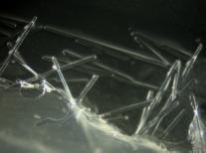
Fibres maximize BONDING
Bond strength to dentin
Effective, whatever bonding agent used
Higher compared to same bonding agent and different composite
everX Posterior base showed reliable bonding to dentine surface.
Source: GC R&D Department , Tokyo, Japan(unpublished data)
Notes:
everX Posterior base showed reliable bonding to dentine and enamel surfaces.

Slide 18



4 mm increments can be cured simultaneously
Enjoy an convenient 4 mm application
Minimum width of 3mm
Placement in 4 mm thick layer
Outer composite of 1-2 mm thick
Source: University of Turku, Finland, 2012 (unpublished data)

Slide 19

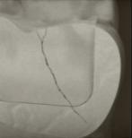

everX Posterior- Features & Benefits
Fibres bring strength to the restoration: fracture toughness to the level of natural dentin and almost double to conventional composite
This makes everX Posterior a prefect sub-structure to reinforce any composite restoration in large size cavities.
Fibres prevent crack propagation
Improve longevity of restorations since fracture is one of the major cause of composite failures
Prevents catastrophic cracks in teeth
Fibres maximize bonding
High bond strength to any overlaying composite and to tooth structures
4 mm increments can be cured simultaneously
Dentists can enjoy a shorter procedure time
Notes:
Restore heavily damaged teeth in a biomimetic way
everX Posterior replace damaged tissue- especially dentin-
conventional composite such as G-aenial Posterior is used as enamel replacement.
Fibres bring strength to the restoration:
Fibres simulate the collagen in the dentine & provide a fracture toughness to the level of natural dentin and almost double to conventional composite
This makes everX Posterior a prefect sub-structure to reinforce any composite restoration in large size cavities.
Fibres prevent crack propagation
Improve longevity of restorations since fracture is one of the major cause of composite failures
Fibres maximize bonding
High bond strength to any overlaying composite and to tooth structures

Slide 20
everX Posterior - Indications
everX Posterior is a dentin replacement material indicated to reinforce direct composite restorations, especially in large posterior cavities, for example:
Cavities including 3 surfaces or more
Cavities with missing cusps
Deep cavities (including class I, II and endodontically treated teeth)
Cavities after amalgam replacement
Cavities where onlays & inlays would also be indicated
Note: everX Posterior should always be covered with a layer of light-cured universal restorative composite, for sufficient wear resistance

Slide 21
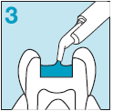
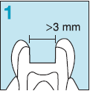
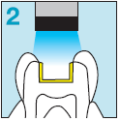
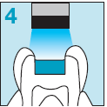
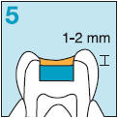
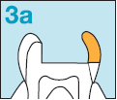
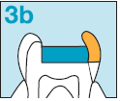
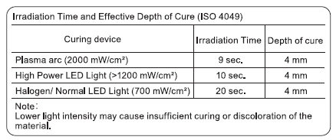
everX Posterior – Step by step
Enjoy an easy 4 mm application in large size cavities
Class I cavities
3. Place everX posterior in layer up to 4mm
Class II and large cavities
1. Prepare cavity
2. Bond and light-cure
4. Light-cure 10-20 sec.
5. Cover with composite
3a. Build first the missing wall(s) with composite
3a. Apply everX Posterior in layer up to 4mm

Slide 22
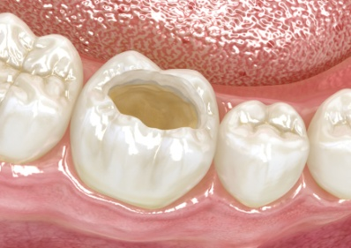
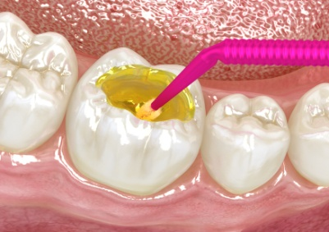
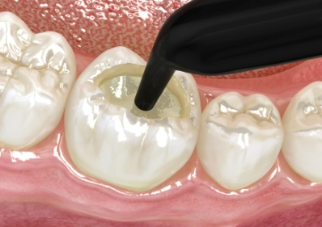
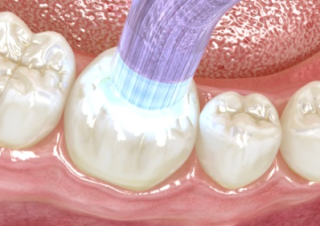
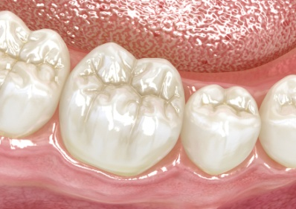
everX Posterior – Step by step
Enjoy an easy 4 mm application in class I cavities
1. Prepare cavity
2. Bond and light-cure
3. Apply everX Posterior in layer up to 4mm
4. Light-cure 10-20 sec.
5. Cover with composite

Slide 23
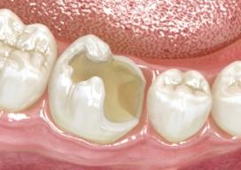
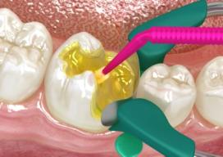
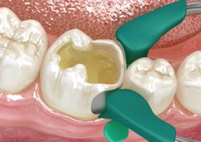
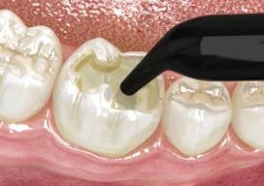

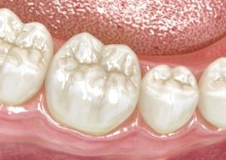
everX Posterior – Step by step
Reinforce class II an larger cavities
1. Prepare cavity
2. Bond and light-cure
3a. Build first the missing wall(s) with composite
3a. Apply everX Posterior in layer up to 4mm
4. Light-cure 10-20 sec.
5. Cover with composite

Slide 24
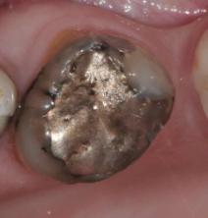
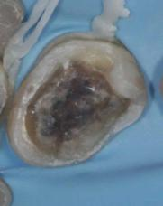
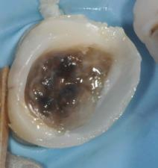
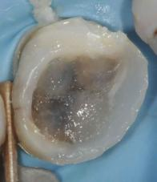
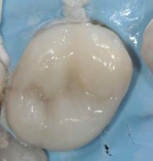
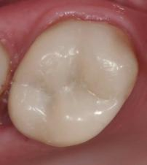
everX Posterior – replacing old amalgam
1. Initial situation
2. Prepare cavity and apply bonding
3. Build the external walls with composite
Courtesy Prof M. Peumans, Leuven, Belgium
4. Apply everX Posterior up to 4 mm layer
5. Apply outer composite layer
6. Check Occlusion & polish
Notes:
Pre-operative view
Prepare the cavity and apply Bonding agent and light-cure. Optionally apply a flowable composite such as G-aenial Universl Flo
Place everX Posterior up to 4 mm layer using a plunger-type instrument and light Cure 10 to 20 seconds
Build the missing wall(s) with conventional composite. The walls should be thick enough to withstand application pressure of everX Posterior
Cover with wear resistant composite such as G-aenial Posterior or G-aenial Universal Flo. This last occlusal layer should be 1-2 mm thick

Slide 25





everX Posterior – replacing old amalgam with missing cusp(s)
1. Defective amalgam restoration
2. Cavity preparation
3 Build-up of missing walls with composite
Courtesy Prof M. Peumans, Leuven, Belgium
4. Application of everX Posterior
5. Final restoration after final layer of composite

Slide 26






everX Posterior – restoration after endo treatment
Initial situation
Prepare cavity and apply bonding
Build the external walls with composite
Courtesy Dr J. Sabbagh, Belgium
Apply everX Posterior in 4 mm layer
Light-cure & apply outer composite layer
Check Occlusion & polish
Notes:
Pre-operative view
Prepare the cavity and apply Bonding agent and light-cure. Optionally apply a flowable composite such as G-aenial Universl Flo
Place everX Posterior up to 4 mm layer using a plunger-type instrument and light Cure 10 to 20 seconds
Build the missing wall(s) with conventional composite. The walls should be thick enough to withstand application pressure of everX Posterior
Cover with wear resistant composite such as G-aenial Posterior or G-aenial Universal Flo. This last occlusal layer should be 1-2 mm thick

Slide 27





everX Posterior – reinforcement of large restorations
Cracked tooth after amalgam restorations
Old amalgam restoration
Courtesy Dr S.Browet, Belgium
Visible crack in cavity
Bonding application
Application of G-aenial Flo

Slide 28






everX Posterior – reinforcement of large restorations
Cracked tooth after amalgam restorations
Application of everX Posterior
Modellation with a micro-brush
Before light-curing
Courtesy Dr S.Browet, Belgium
everX posterior after light-curing
Application of G-aenial Posterior enamel shade JE
Final view after finishing and polishing

Slide 29




everX Posterior – reinforcement of large restorations
Deep cavities after endodontic treatment
Courtesy Dr Veleninov, Bulgaria
Initial situation
Prepare cavity and apply bonding
Apply everX Posterior in up to 4 mm layer
Check Occlusion & polish

Slide 30





everX Posterior – Reinforcement of large restorations
Large class II cavity
Courtesy Dr R. Zunzarren, France
1 Defective composite restoration
2. Cavity preparation
3 Build-up of missing walls with G-aenial Posterior
4. Application of everX Posterior
5. Final restoration after final layer of G-aenial Posterior

Slide 31




everX Posterior – Reinforcement of large restorations
Cavities including 3 surfaces or more
1. Cavity preparation
2. Build-up of missing walls with composite
Courtesy Dr M. Diernaes, DK
3. Application of everX Posterior
4. Final restoration after final layer of composite

Slide 32





everX Posterior – Reinforcement of large restorations
cavities where inlays or onlays would also be indicated
Courtesy Dr Y. Marinova, Bulgaria
1 Defective composite restoration
2. Cavity preparation
3 Build-up of missing walls with G-aenial Posterior
4. Application of everX Posterior
5. Final restoration after final layer of G-aenial Posterior

Slide 33






everX Posterior – Reinforcement of large restorations
Cavity where inlay or onlay would also be indicated
Courtesy Dr Crnojevic,HR

Slide 34

everX Posterior - Radiopacity
everX Posterior has sufficient radio-opacity for clinical applications as seen from the X-ray image below.
Courtesy Dr Mach, Tchek Republic
Source: GC R&D Department, Tokyo, Japan, 2012
* Tsuge T. J Oral Sci 2009; 51(2): 223-230

Slide 35

everX Posterior – Packaging
Ar Nb West | Art. Nb East | Description | WSP til April 30th | WSP May 1st | SRP
005117 | 005118 | everX Posterior, Unitip, 15 x 0.13 ml (0.25g) | 47.5 € | 57,7€ | 67.9 €
Shade
Universal
Shelflife
2 years
Official date of availability:
IDS

Slide 36
everX Posterior - Fieldtest overview
41 users
253 restorations in place!
Handling/ adaptation
63% used average layer of 3mm
63% found the handling acceptable, (37% viscous)
49% found the material non-sticky (while 37% sometimes sticky and 15% always)
59% judged cavity adaptation good, 20% excellent

Slide 37
everX Posterior - Fieldtest overview
Shade
Shade of everX after Light-curing: 51% Good or excellent, 32% average 14% poor
Outcome
88% never experienced post-op sensitivity
54% judged final outcome good and 31% excellent

Slide 38
everX Posterior – acceptance of concept

Slide 39
everX Posterior – Fraquency of use
Frequency of use
In average, 8 restorations perform a week on vital teeth where everX could be used
In average, 4.5 restorations perform a week on non-vital teeth where everX could be used

Slide 40
everX Posterior- Positioning
everX Posterior is a short fibre-reinforced composite designed to replace damaged tissue- especially dentin- in conjunction to conventional composite such as G-aenial Posterior used as enamel replacement. The combination of both materials allows to restore teeth, and especially large cavities, in a bio-mimetic way.
GC everX Posterior is the strongest composite sub-structure that helps you to go extend beyond the current limitations of direct restorations

Slide 41
Is everX Posterior only a base?
Restorative option
Indirect
Direct
Implant
Aadva
C&B
Initial
Inlay/ Onlay
Gradia Lab
FRC
everX Posterior + G-ænial
Composite
G-ænial
High Viscosity Flowable
G-ænial Universal Flo
Reinforced GIC
EQUIA
GIC
Fuji IX
Cavity Size
MI Cavity
Class I & II non bearing
Class I load bearing
Class II Load bearing
Endo treated tooth
1 or 2 Missing cusp
1 wall Left
Sub-gingival root fracture

Slide 42
Bulk –fill composites
GC Options
Small – medium cavities, high caries risk patients
EQUIA: real bulk- including occlusal surface in 1 material
G-ænial Universal Flo: layering BUT no change of syringe, no 40s curing time, perfect adaptation, aesthetic, wear resistance & easy polishing (win time on polishing, not on application!)
Large cavities – Class I & II
Sandwich technique – GIC
everX Posterior + composite: reinforcement, avoid tooth & cusp fracture
Large cavities: 1 or 2 missing cusps, after endo treatment
everX Posterior + composite

Slide 43
GC’s portfolio based on indications
Direct
Indirect
Aadva
Initial
Gradia Lab
everX Posterior + G-ænial
G-ænial
G-ænial Universal Flo
EQUIA
Semi
≤ load bearing
Cavity size
ALL Direct applications

Slide 44
everX Posterior – Market
Competitor to inlay/ onlays
Lab made
CAD/ CAM made (CEREC)
meaning extending the direct restorative market towards indirect.
Competitor to other base/ dentin replacement material
Bulk-fill materials (e.g. SDR from Dentsply)
GIC base material
Flowable base materials
everX Posterior is an innovative product and will not be positioned as direct competitor- me too product – vs. bulk-fill materials

Slide 45
everX Posterior - Key messages
Looking for solution to prevent cracks in restorations & teeth?
GC everX Posterior
The strongest composite sub-structure that helps you to extend beyond the current limitations of direct restorations

Slide 46
everX Posterior– Target users
User a
User looking for answer to prevent cracks in teeth & restorations
Composite failure is being shown as a major reason for replacement of restorations
User b
User looking for viable / sustainable restorative material for large cavities
After amalgam removal (especially with cusp fracture)
When patients have financial limitations requesting direct restorations to be done
After endo treatments

Slide 47
everX Posterior– Supportive materials
Leaflet
The strongest composite sub-structure that helps you to go beyond /reach the limits of direct restorations
Technical manual
Already existing for Xenius, now updated with new data on everX Posterior
Key message: everX Posterior is backed by scientific proofs which sustain the large indications
First version available for IDS
New In vitro studies ongoing
Advertising
In line with leaflet,
Fiber-reinforce composite for dentin replacement in large cavities
Sales Sheet
In line with leaflet
Fiber-reinforce composite for dentin replacement in large cavities
Master available for IDS training
Video
Based on Xenius video, updated by Linda
Available for IDS

Slide 48


everX Posterior - Leaflet

Slide 49


everX Posterior - Leaflet

Slide 50


everX Posterior - Leaflet

Slide 51
everX Posterior– Executive summary
Product description
Fiber Reinforced composite for use as Dentin Replacement in extensive size cavities
Positioning
GC everX Posterior is the strongest composite sub-structure that helps you to go beyond /reach the limits of direct restorations by preventing and stopping crack propogation
Key Features
Fibers prevent crack propagation
Fibers bring strength and increase load bearing capacities
Fibers maximize bonding to overlaying composites
Placement in deep layers of 4mm makes procedure easier
Packaging & Pricing
Pack of 15 unitips, WSP 68€
Launch Date
EU launch: IDS
Market
New market segment
Competitor to inaly/ onlay materials
Competitor to dentine subsitute material

Slide 52

Thank you
For your attention

